Slide 1
Games Library
All Your Games are Belong to Us
By Emil O’Brien

Slide 2
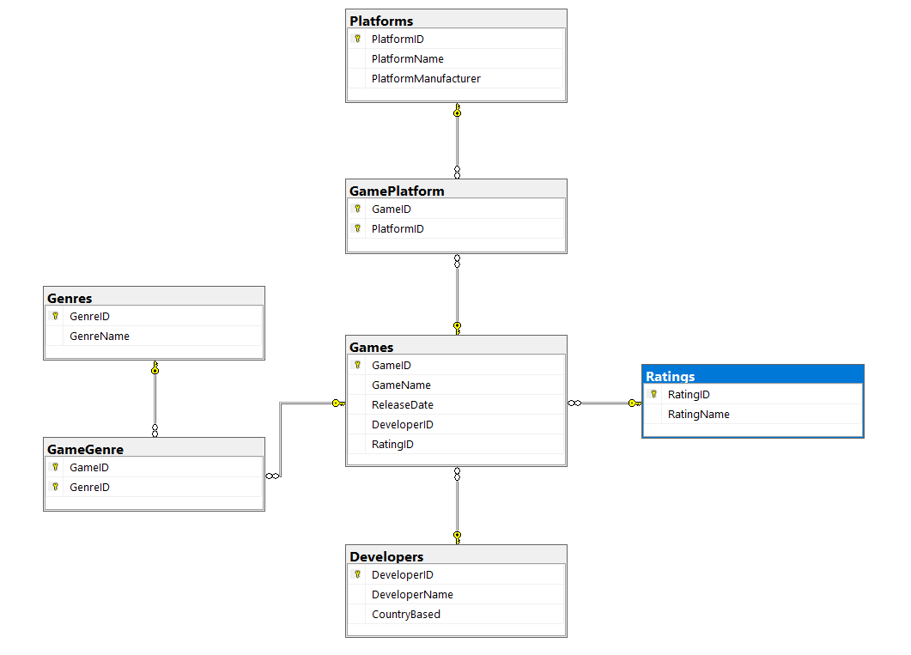
Database Diagram

Slide 3
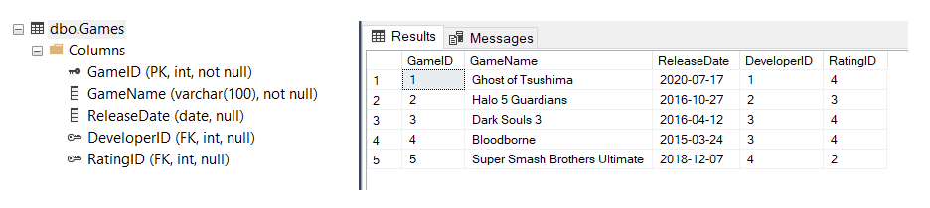
Games Table

Slide 4
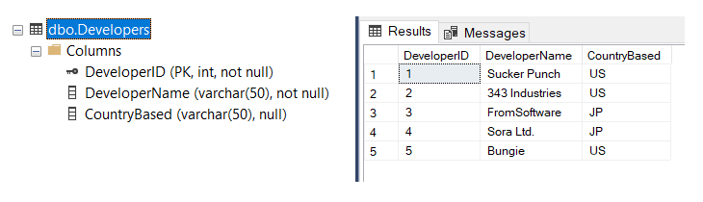
Developers Table

Slide 5
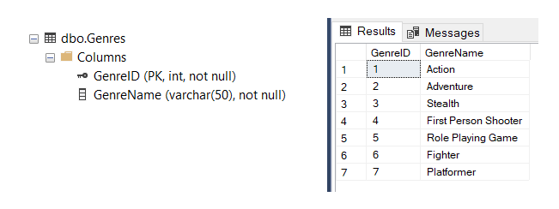
Genres Table

Slide 6
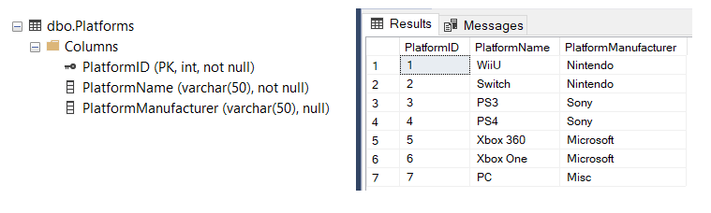
Platforms Table

Slide 7
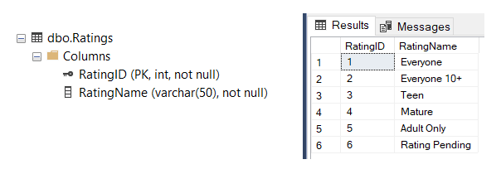
Ratings Table

Slide 8
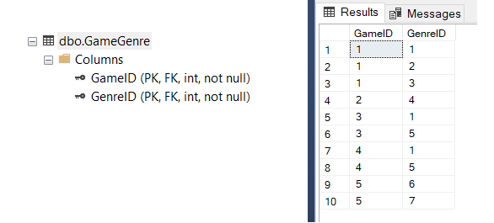
GameGenre Linking Table

Slide 9
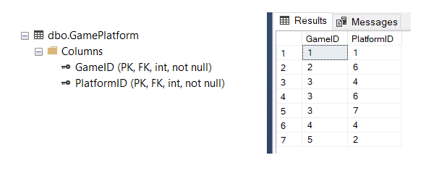
GamePlatform Linking Table

Slide 10
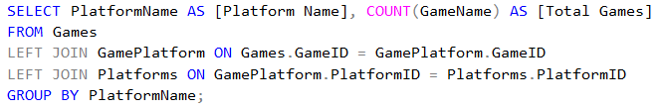
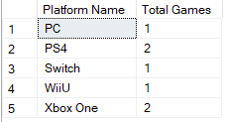
Summary Query 1
Get a count of games per platform

Slide 11


Summary Query 2
Get the Highest rated game

Slide 12
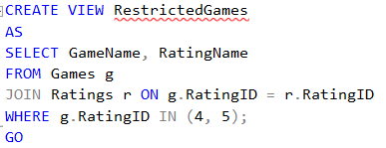

View 1
View for Games that are restricted by rating

Slide 13
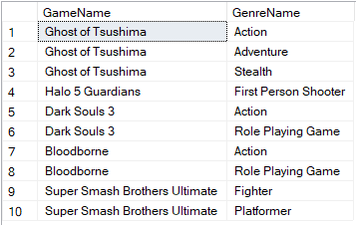
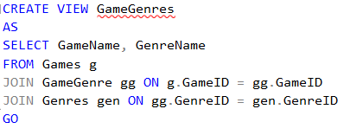
View 2
View for Games and their Genres

Slide 14
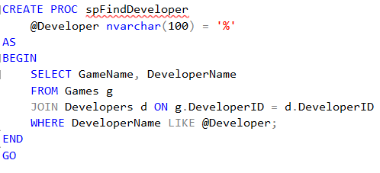
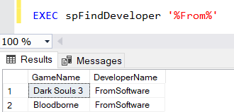
Stored Procedure 1
Find Games based on the Developer

Slide 15
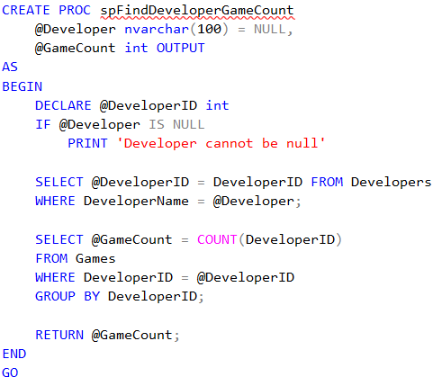
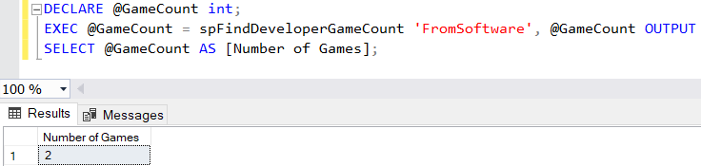
Stored Procedure 2
Find Number of games the given Developer has made

Slide 16
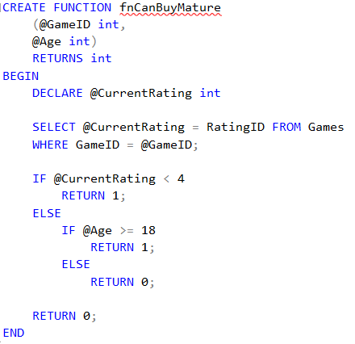
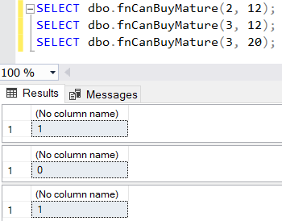
Function 1
Check to see if the age is old enough to purchase mature rated game
0 = No, 1 = Yes

Slide 17
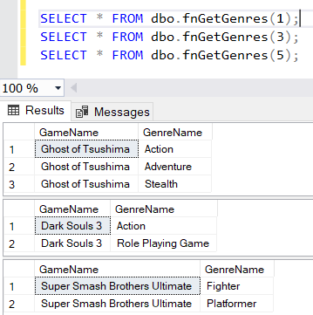
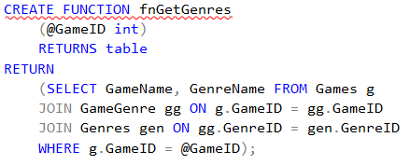
Function 2
Gets the Genre based on a Game ID

Slide 18
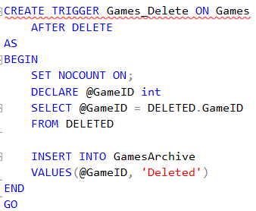
Trigger 1
Archives Games that are deleted

Slide 19
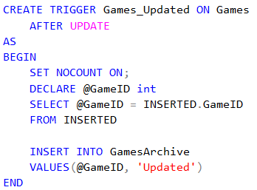
Trigger 2
Archives Games when updated

Slide 20
What went well
Creating the Database itself
Tables, Linking Tables, etc.
Creating the Views

Slide 21
What did you have problems with
My database does not have many quantitative values, so aggregate functions were difficult to design

Slide 22
What did you learn
I mainly learned about the advanced aspects like functions, triggers, and stored procedures

Slide 23
What would you like to include in future releases
I would like to include reviews of the games from well known sources

